Slide 1

Industrial Machine Monitoring System
University of Franche-Comté
Students:
ZAHRAMAN Bilal
KHALIL Omar
Prof:
AZAR Joseph

Slide 2
Summary of our idea: The Industrial Machine Monitoring System is an IoT solution that monitors machine health, detects anomalies, and alerts maintenance teams to prevent breakdowns. What is our project about: The Industrial Machine Monitoring System is an IoT-based solution designed to track the health of industrial machines in real-time. It uses sensors to collect data on vibration, temperature, and current to detect anomalies. The system processes this data and sends alerts to maintenance teams if potential issues are detected. The goal is to prevent machine breakdowns, reduce downtime, and improve operational efficiency.

Slide 3
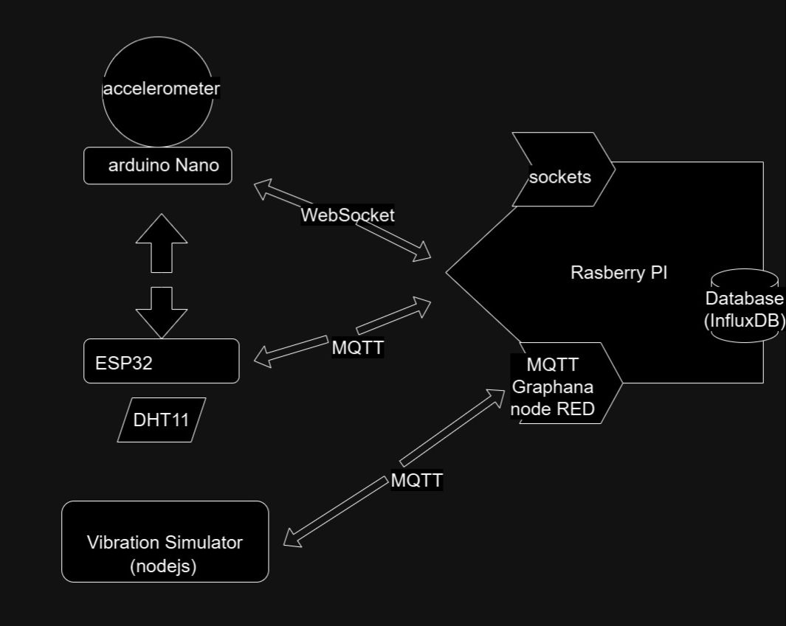
Architecture
we are using an RPI with usb
Using Docker we installed:
Mosquitto
InfluxDB
NodeRed
Graphana

Slide 4
Sensors / Collected Data: Simulator Vibration Sensor: Collects vibration data to monitor machine performance and detect any irregularities in vibration levels. DHT11 Temperature and Humidity Sensor: Collects temperature and humidity data, helping to monitor machine temperature and environmental conditions. Accelerometer: Measures acceleration in multiple axes (X, Y, Z), helping to detect mechanical issues through abnormal movement or vibrations.

Slide 5
Storage
We use MQTT and WebSocket protocols to transmit data to an InfluxDB database hosted on a Raspberry Pi. We employ MQTT for sending data from the ESP32, including temperature, humidity, and vibration simulator readings. For transmitting accelerometer data from the Arduino, we use WebSocket. The data is then stored in the database for monitoring and analysis. This setup enables seamless communication between our IoT devices and efficient data storage for further processing.

Slide 6
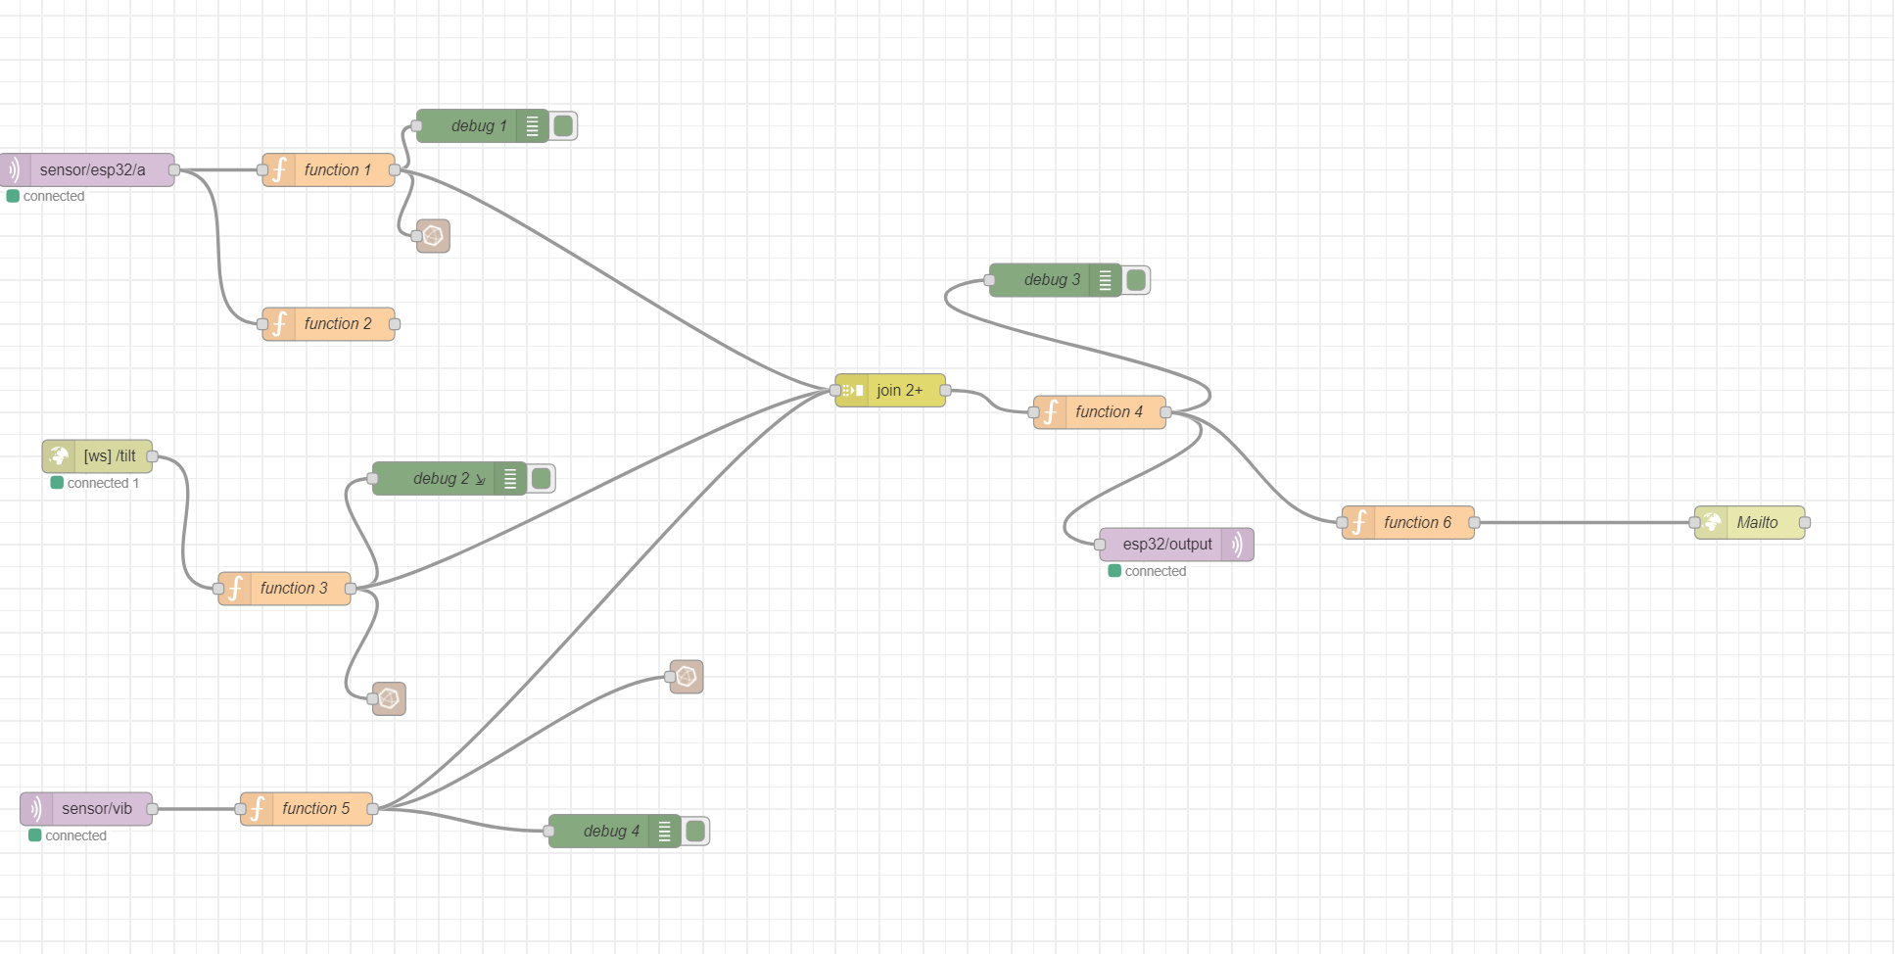
Processing

Slide 7
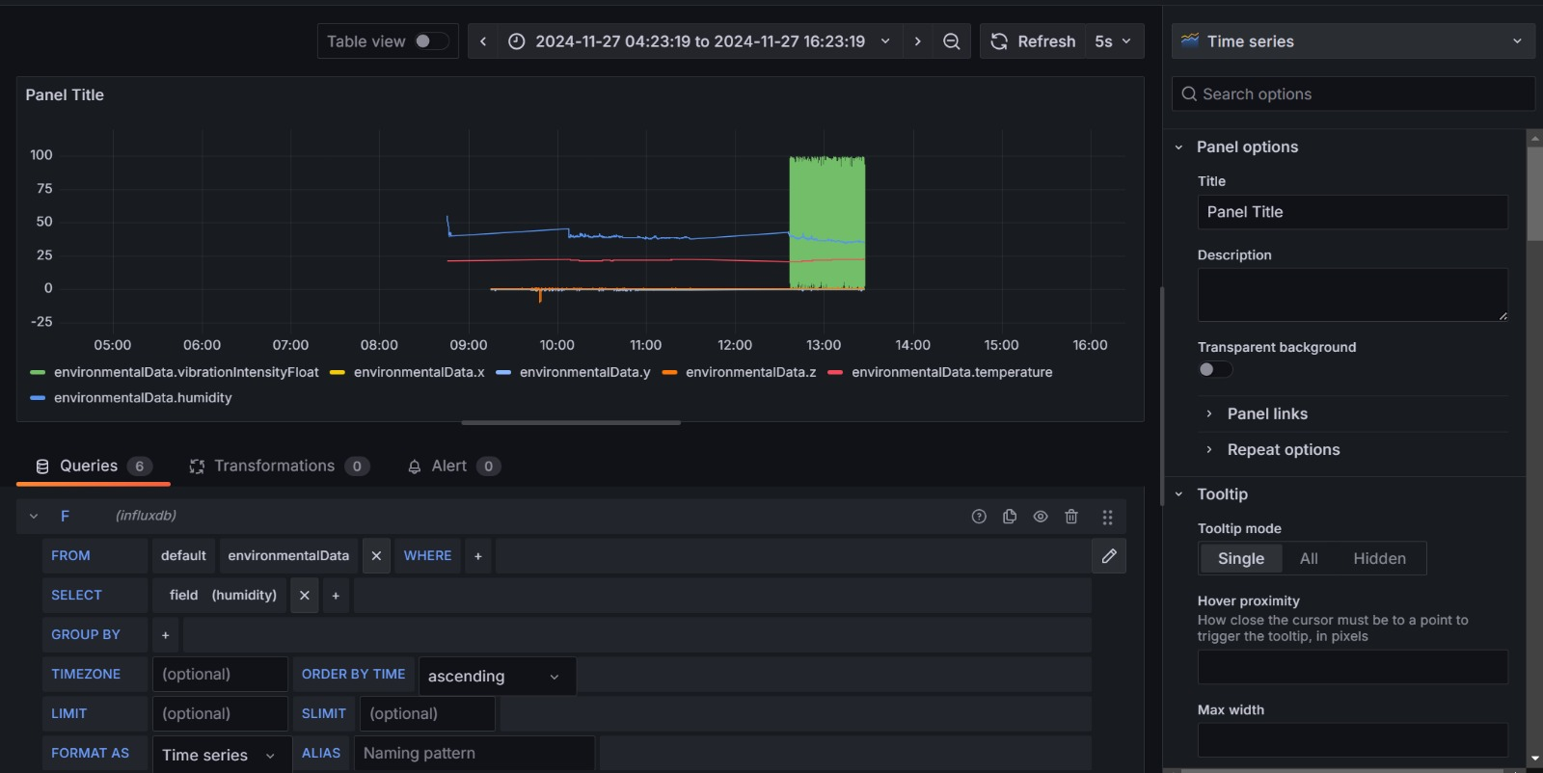
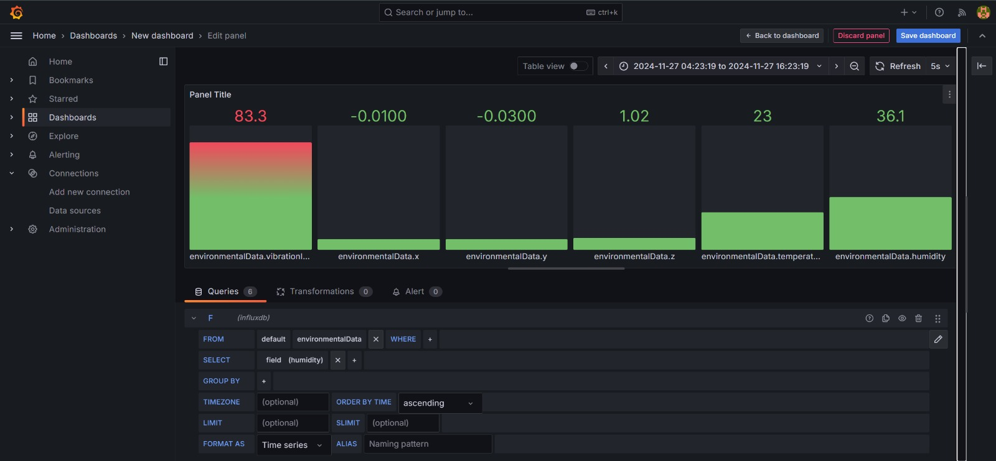
Visualisation
Timeseries:
Barchart:

